Slide 1
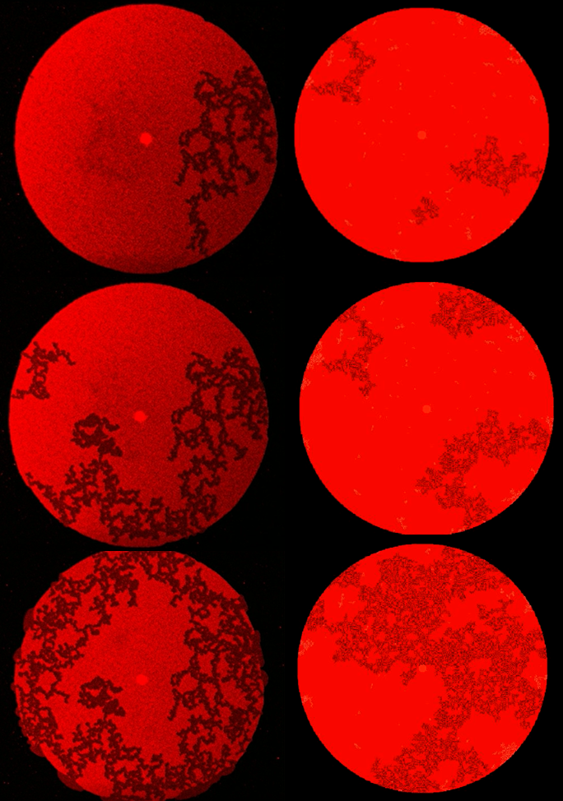
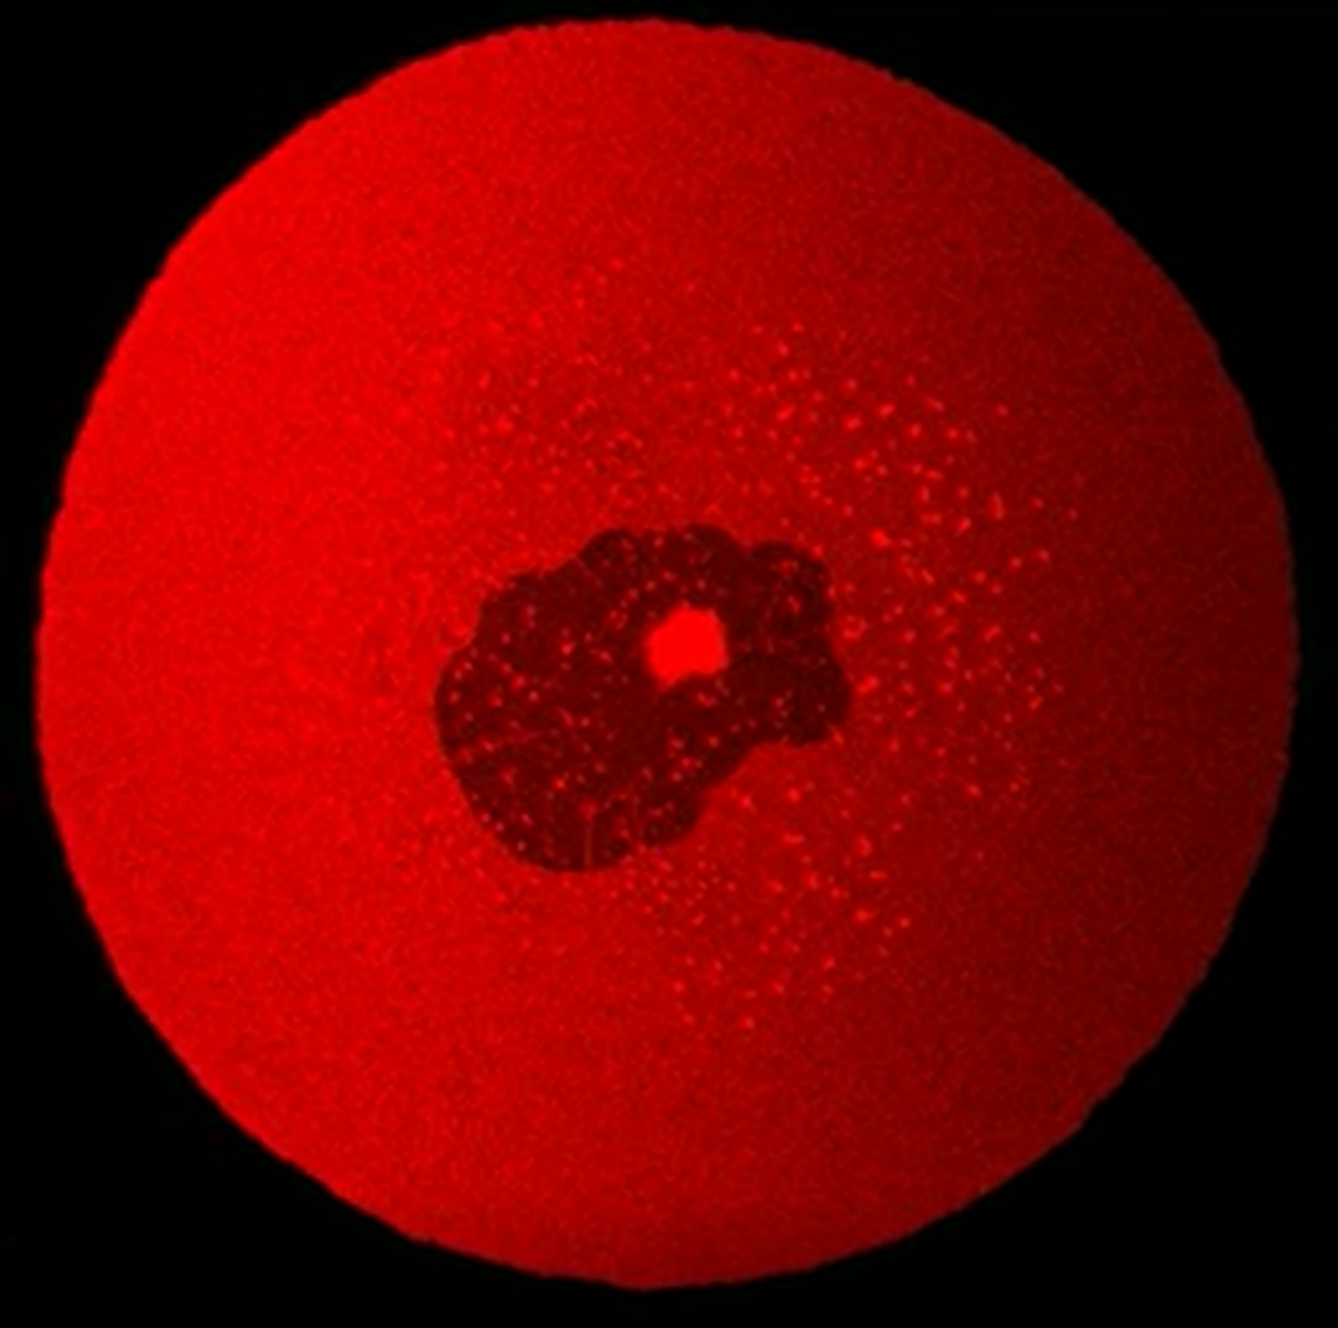
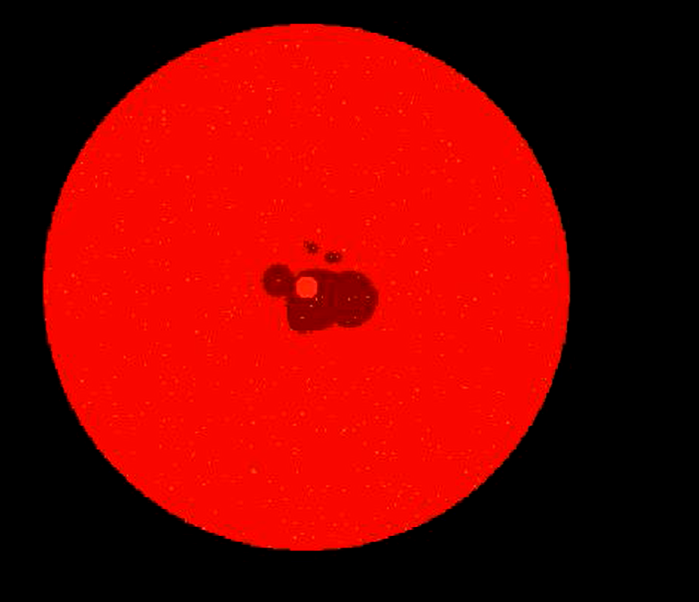
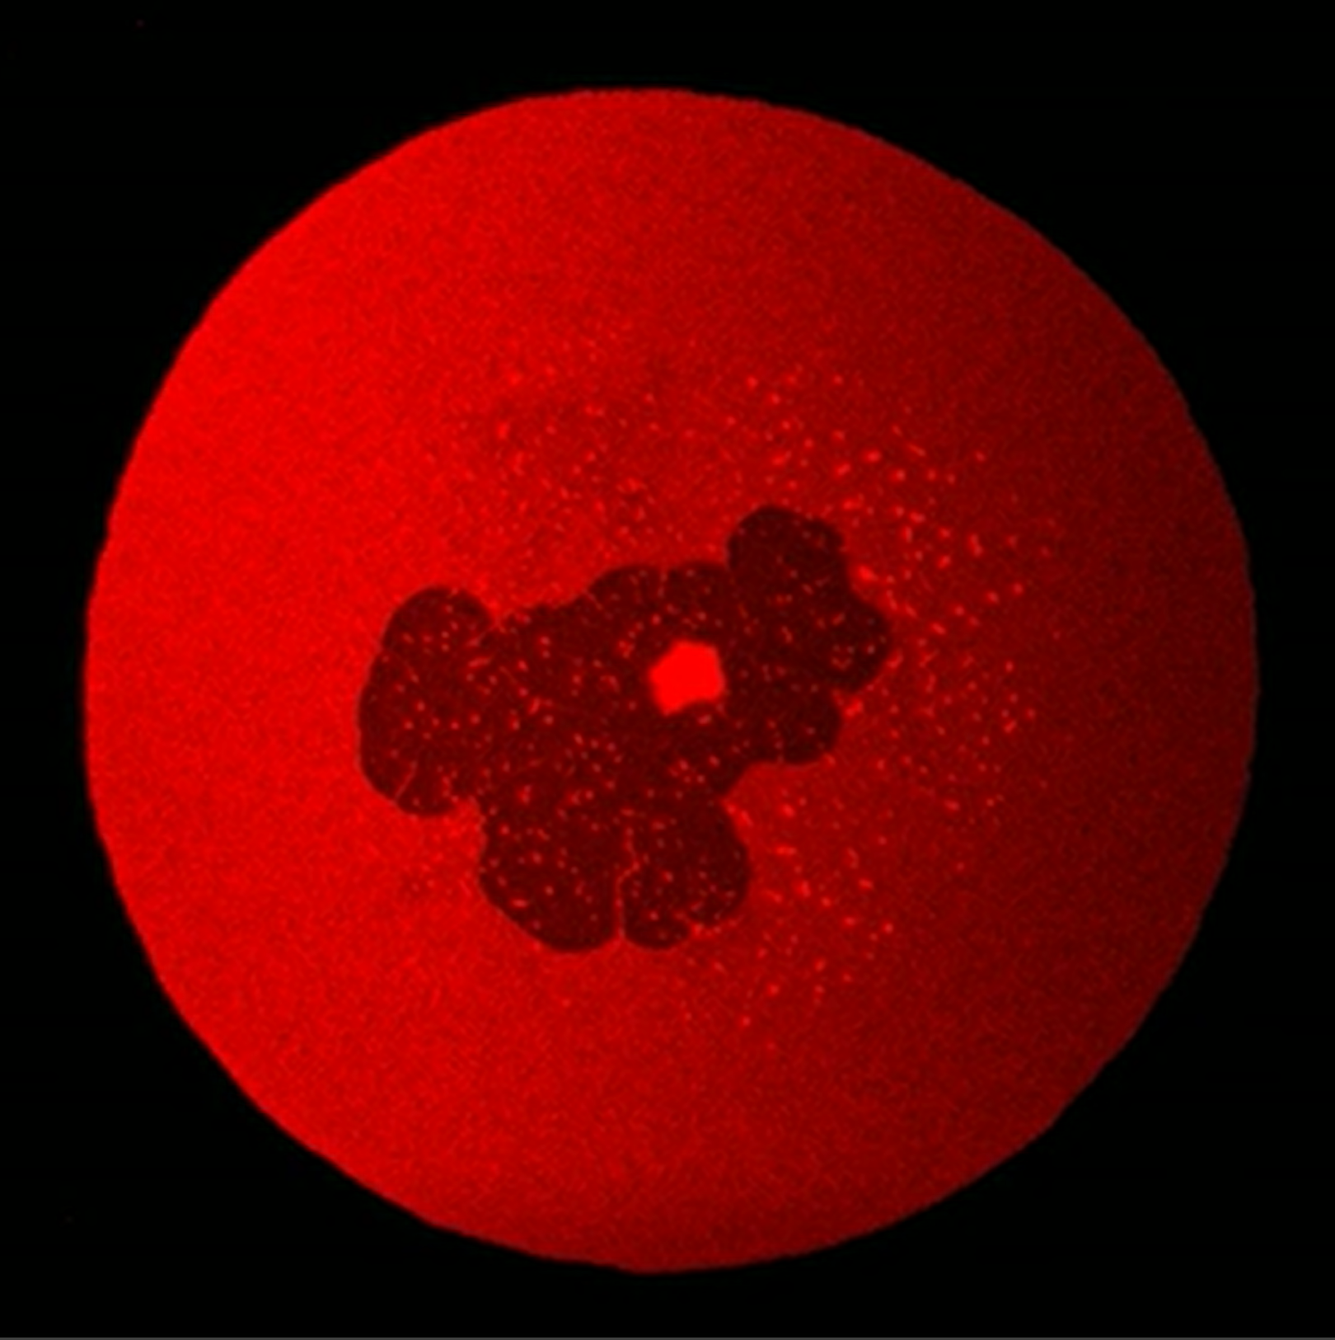
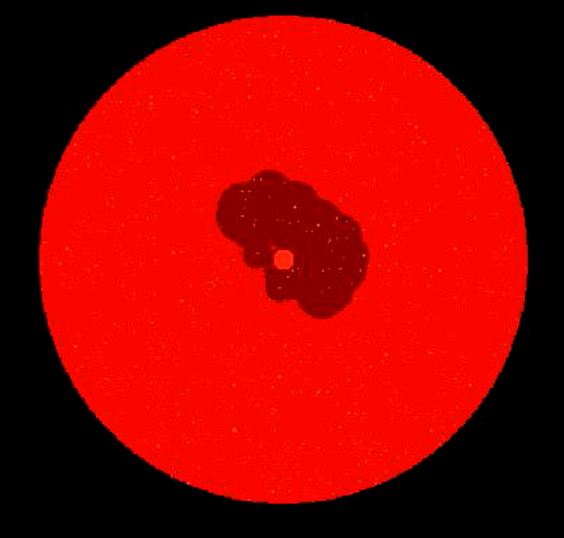
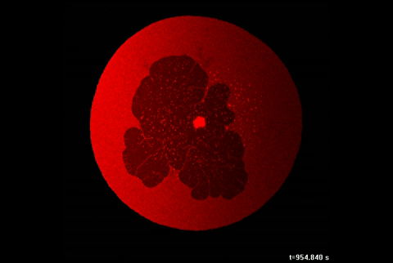
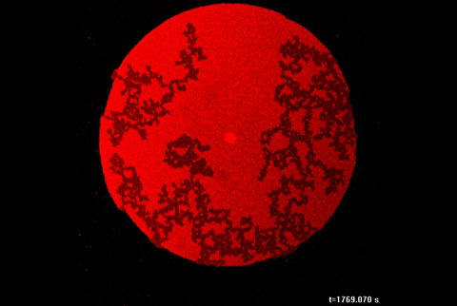
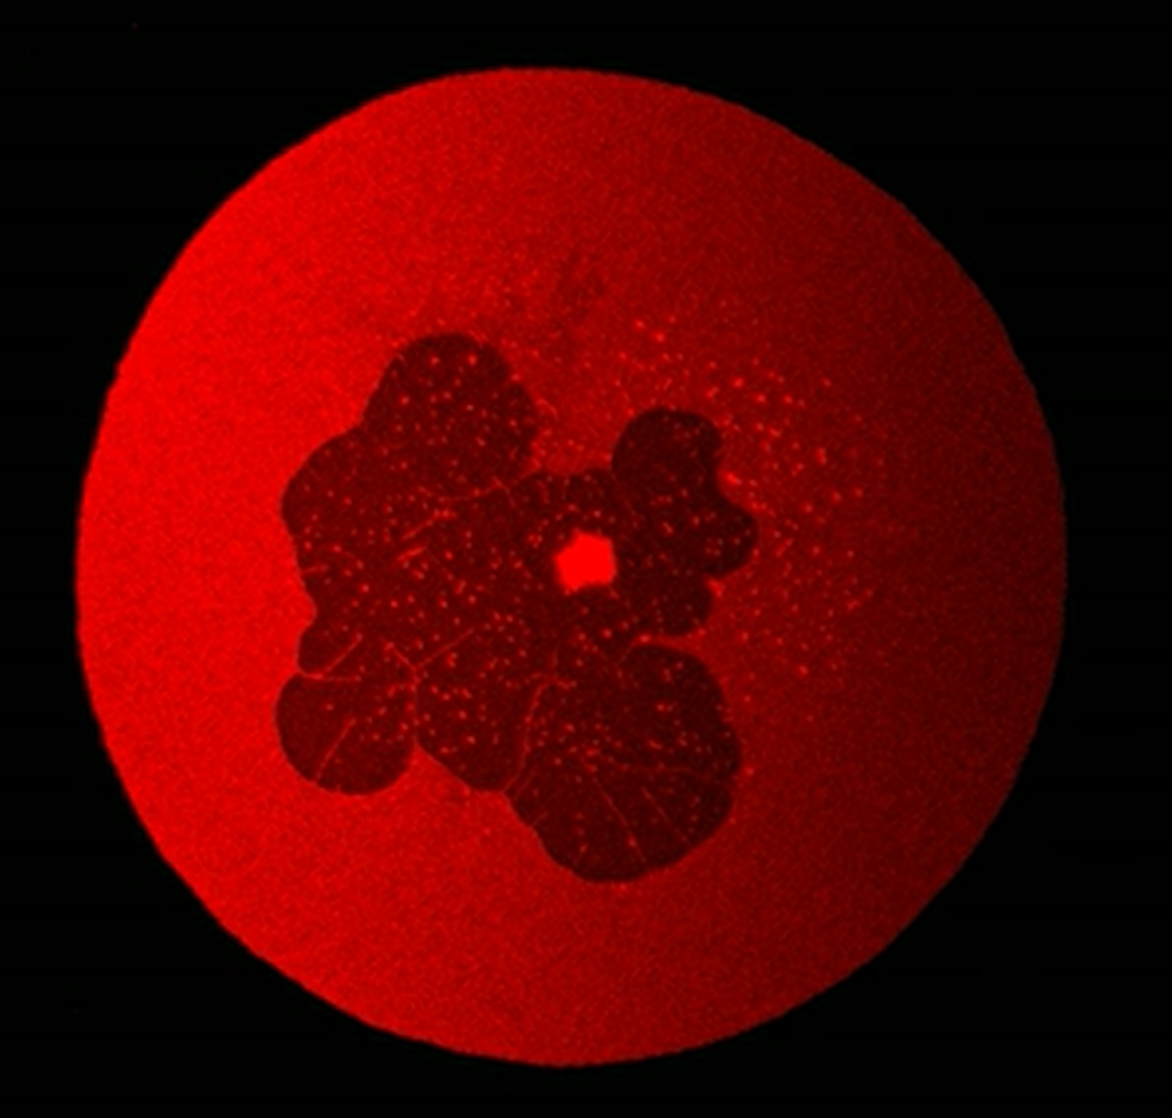
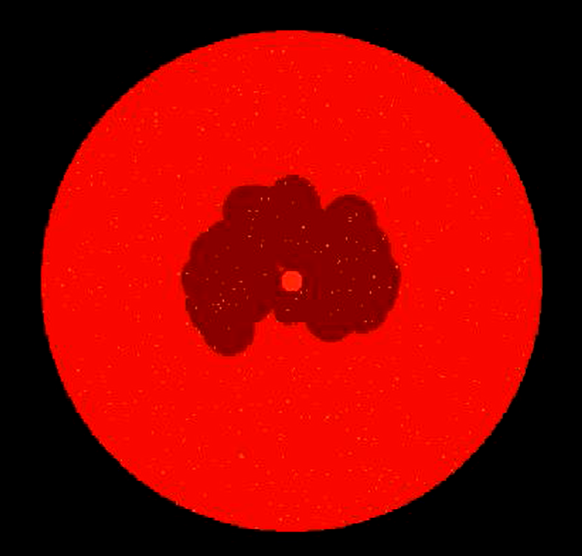
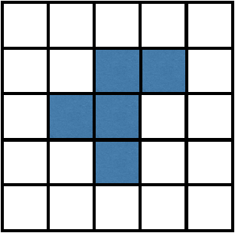
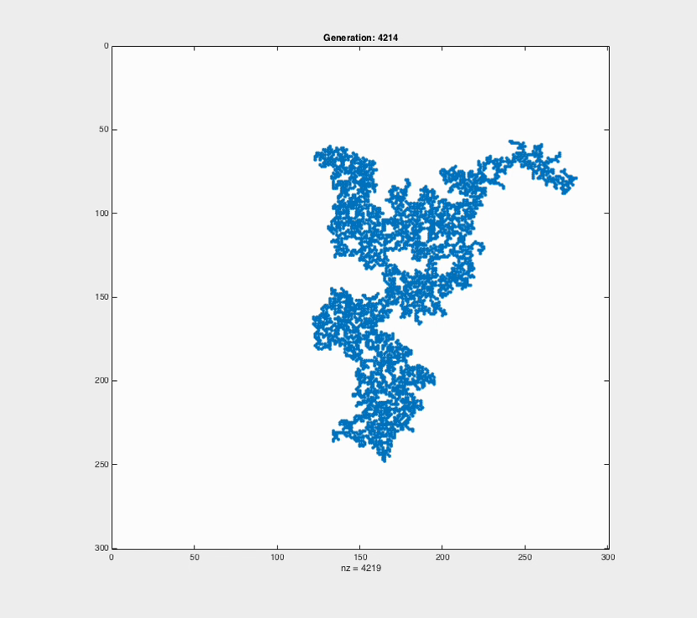
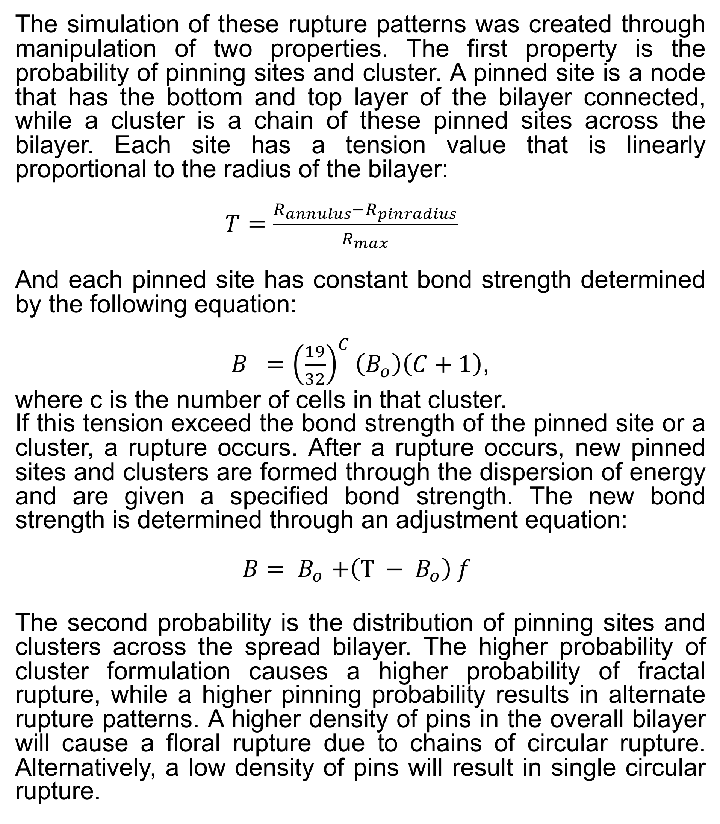
Simulation of Lipid Membrane Rupture via Cellular Automation Abhay Gupta¹, Irep Gözen², and Michael Taylor¹ ¹Department of Mechanical Engineering, Santa Clara University. ²Centre of Molecular Medicine Norway, University of Oslo.
Introduction
Simulation Overview
Results
Lipids are the fundamental structural component of biological cell membranes. Under tensile stress, these membranes form transient ruptures. Unchecked membrane ruptures are implicated in serious ailments such as muscular dystrophy, CTE, and vibration white finger. Understanding and controlling rupture formation has important implications in, e.g., gene therapy and drug delivery.
In model double bi-layer lipid membranes spreading on a solid surface, several rupture morphologies have been observed, including floral and fractal patterns [1]. Unfortunately, the underlying mechanics are too small to observe experimentally.
The simulation of these rupture patterns was created through manipulation of two properties. The first property is the probability of pinning sites and cluster. A pinned site is a node that has the bottom and top layer of the bilayer connected, while a cluster is a chain of these pinned sites across the bilayer. Each site has a tension value that is linearly proportional to the radius of the bilayer:
$T=\frac{R_{annulus}−R_{pinradius}}{R_{max}}$
And each pinned site has constant bond strength determined by the following equation:
$B ={\left(\frac{19}{32}\right)}^{C}\left(B_{o}\right)\left(C+1\right)$,
where c is the number of cells in that cluster.
If this tension exceed the bond strength of the pinned site or a cluster, a rupture occurs. After a rupture occurs, new pinned sites and clusters are formed through the dispersion of energy and are given a specified bond strength. The new bond strength is determined through an adjustment equation:
$B{= B}_{o}+\left(T − B_{o}\right) f$
The second probability is the distribution of pinning sites and clusters across the spread bilayer. The higher probability of cluster formulation causes a higher probability of fractal rupture, while a higher pinning probability results in alternate rupture patterns. A higher density of pins in the overall bilayer will cause a floral rupture due to chains of circular rupture. Alternatively, a low density of pins will result in single circular rupture.
Experiment
Simulation
Experiment
Simulation
50 μm
Time
Gen.
Time
Gen.
Floral
Fractal
Objectives
The primary goal of this research is to develop a computational model for rupture in lipid membranes, examining specifically why different fracture morphologies appear and how the fracture morphology is a function of membrane properties and lipid structure. Research activities include
Develop a 2D Cellular Automation of lipid membrane pining and rupture using Matlab
Make qualitative comparisons of simulation results with experimental data
Summary and Future Work
The simulation shows good quantitative accuracy to the experimental results across a range of rupture morphologies. This provides some evidence that the pinning can contribute to the appearance of the different morphologies found in the labb
However, further investigation must be made in order to quantitatively justify these results and determine how to utilize them to control or eliminate ruptures completely. These quantitative studies include determining the dimension of the fractal pattern and the area of fracture for floral patterns, as well as comparing the rates of fracture among all rupture patterns.
Algorithm
Create initial state of circular lipid CA cells
Expand lipid by one cell radially
Determine whether cell becomes a regular pin or cluster pin site based on user-defined probabilities P_{n} and T, respectively
Compute tension in pinned cells
Invasion percolation routine to determine cluster growth throughout lipid
Recompute tensions in pinned cells
If tensions are greater than a critical value B, cells “fracture” and release energy as dictated by whether they are a regular or cluster pin
Loop back to 2 and repeat for N generations
Cellular Automation
Cellular automation (CA) is a discrete numerical model consisting of a grid of cells that can take on one of a finite set of states(e.g., on or off). The state of a cell is changed, or evolved, according to very simple rules based on the state of its neighbors. It has commonly been used to describe fluid movement through porous structures as well as growth and decay areas in ecology [2,3].
References
[1] Gözen et al. Fractal avalanche ruptures in biological membranes. Nat. Mat. 9, 908-912 (2010).
[2] O'Sullivan & Perry, Spatial Simulation: Exploring Pattern and Process, Wiley-Blackwell, 2013.
[3] Feder & Torstein, Fractal Patterns in Porous Media Flow, Fractals in Geology and Earth Processing, 1996.
Acknowledgements
Generation: 1
Generation: 4000
This work has been supported by the Kuehler Undergraduate Research Grant administered by the SCU School of Engineering

Slide 2
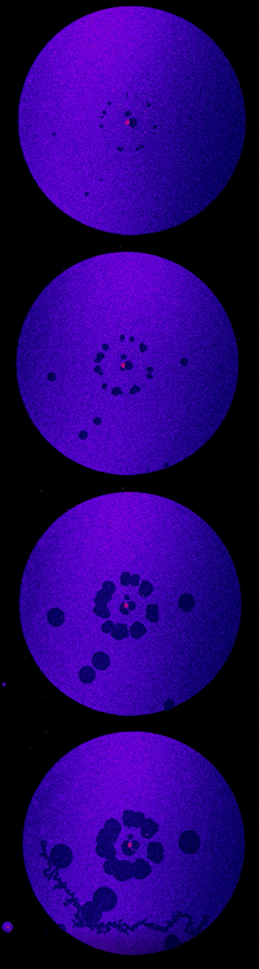
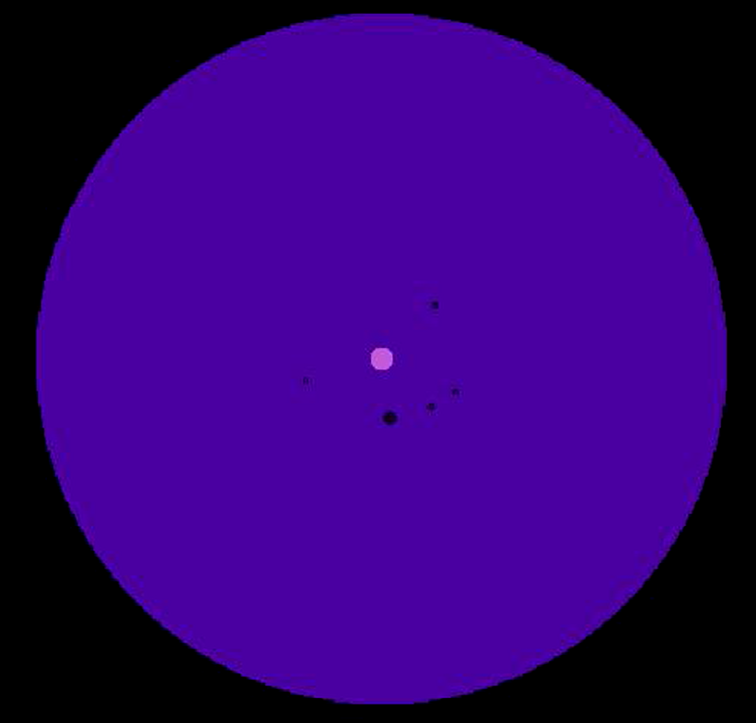
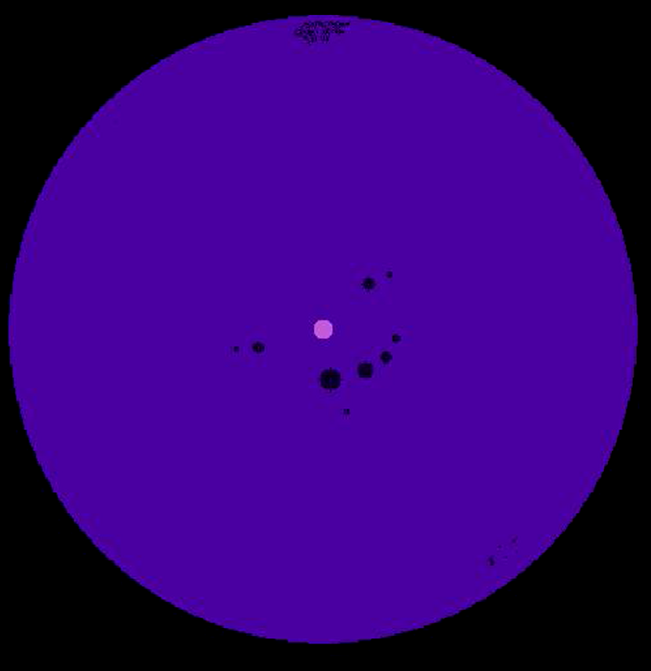
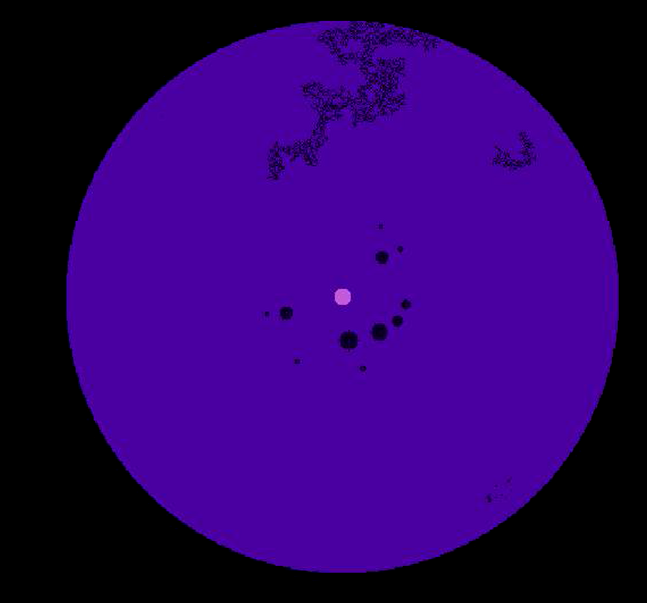

Slide 3
Create initial state of circular lipid CA cells
Expand lipid by one cell radially
Determine whether cell becomes a regular pin or cluster pin site based on user-defined probabilities P_{n} and T, respectively
Compute tension in pinned cells
Invasion percolation routine to determine cluster growth throughout lipid
Recompute tensions in pinned cells
If tensions are greater than a critical value B, cells “fracture” and release energy as dictated by whether they are a regular or cluster pin
Loop back to 2 and repeat for N generations

